Slide 1
YTC
Patrick Hickey, Victor Adesanmi, Austin Layne, Zach Kombet

Slide 2
Goal
Help IRS keep track of taxpayers efficiently.
Allow taxpayers to
View their tax bracket
Complete their tax forms effortlessly
View past years information
Get help
Allow admins to
Update forms
Update tax brackets
Monitor taxpayer information
Get statistics on taxpayers

Slide 3
Requirements
Accessibility
Cross platform
Disability
Language
Security
HTTPS
Payments and processing
Database
Form validation
Customer Service
Privilege levels
Easy navigation

Slide 4
Use Cases
Creating user account
Get new user data
Filling out tax forms
Select, fill, and submit form
Payments
Add payment method, one time or create a payment plan
Reports
Based on level of authority, select criteria
Modification of tax brackets and forms
Admin feature

Slide 5
What it can do

Slide 6
User Abilities
Able to create an account and update their tax information
Have information stored with their account
Add payment methods and payment plans.
Make changes to their account.
Users are given the choice to decide what tax form to uses (federal or state).
View personal tax history, current tax bracket info, and payment balance information

Slide 7
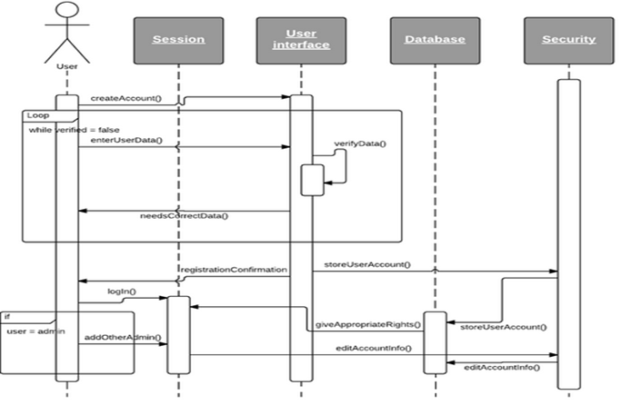
User Creating a New Account

Slide 8
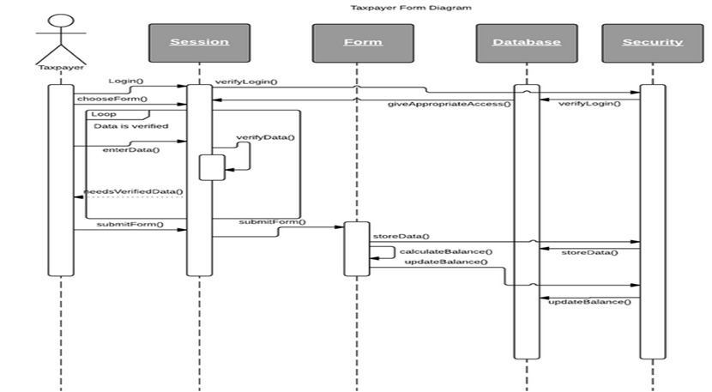
User completing a from

Slide 9
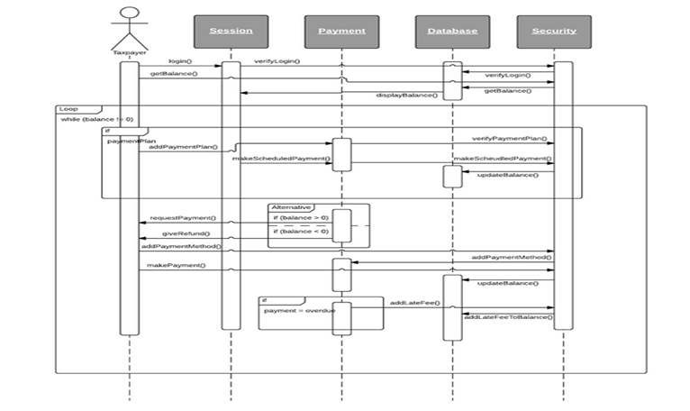
How Transactions Occur

Slide 10
Admins Abilities
Admins can make modifications to the tax bracket.
They have the ability to add, delete, and modify tax brackets.
They can also pull and print data from taxpayer information.
Add other admins.

Slide 11
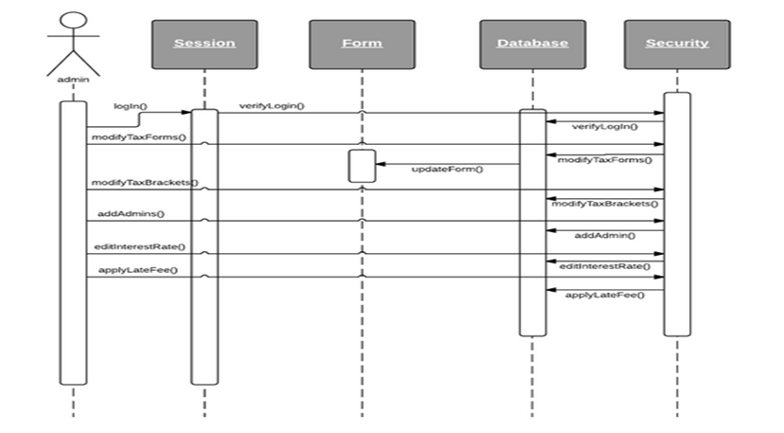
Admin Abilities

Slide 12
Design

Slide 13
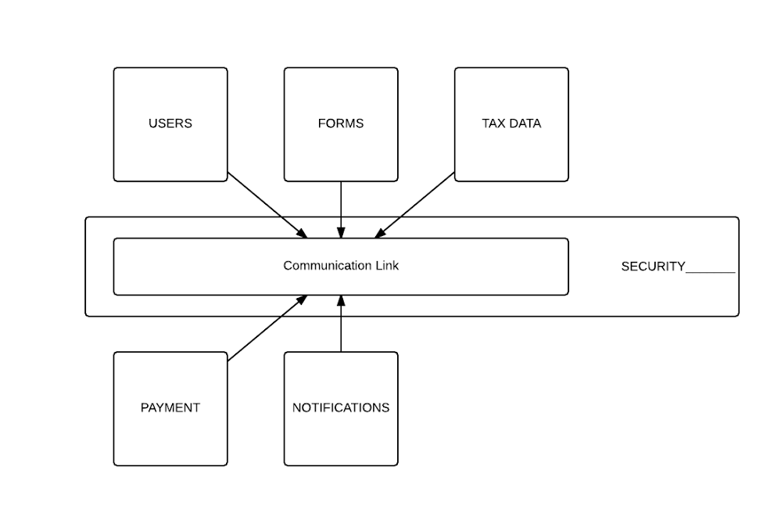
HLA

Slide 14
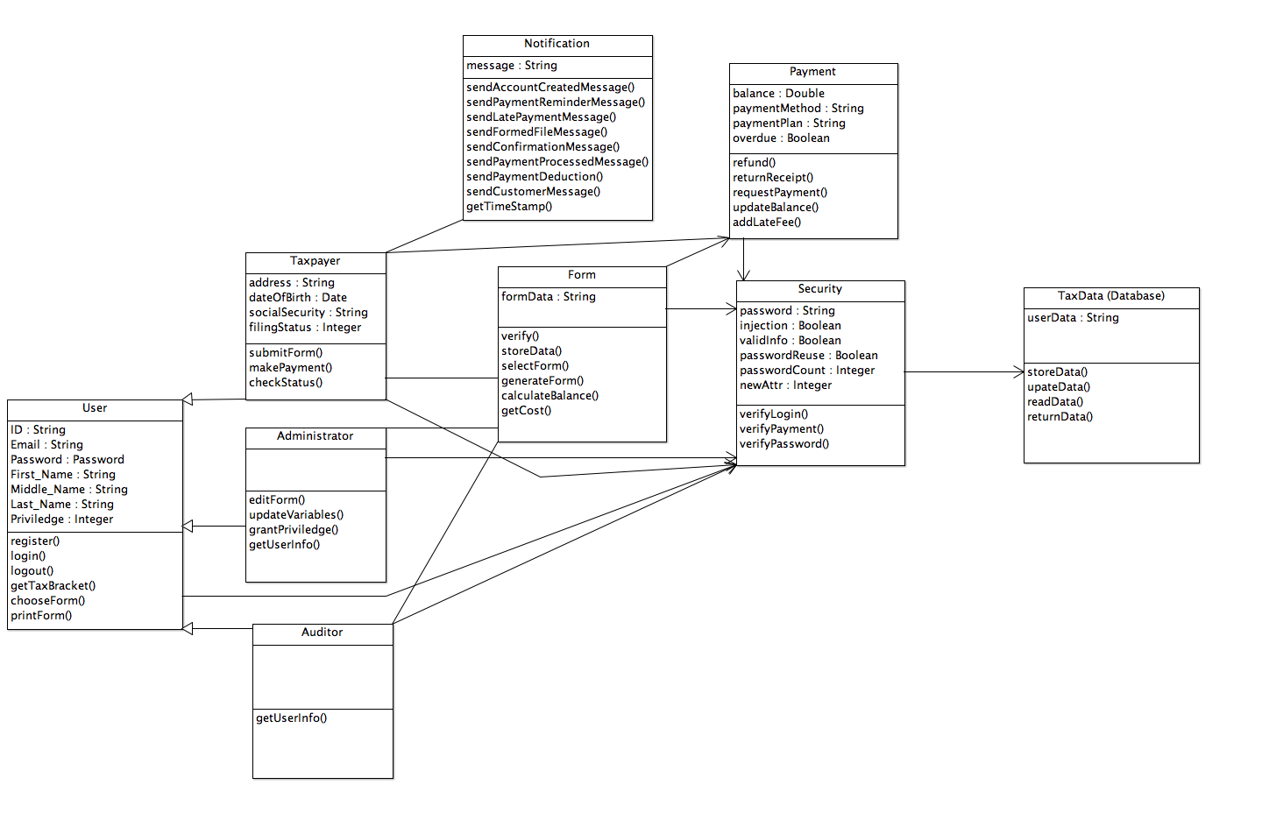
Classes

Slide 15
Tools Used

Slide 16
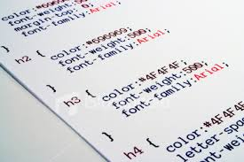

Languages
PHP
Server Side
HTML5
Website
SQL
Database
JavaScript
Form verification
CSS
Style

Slide 17

GitHub
Code repository
Allows each user to update your code on your own machine, then commit it to the repository, and update the project
Also, shows changes that have been updated by each user

Slide 18

Source Tree
3rd party Git client
Used for pushing and pulling code

Slide 19

Cyberduck
FTP client to upload our source files to our web server.

Slide 20

MySQL Workbench
Creating and maintaining database
All taxpayer information will be stored in database

Slide 21
Referenced Materials

Slide 22

Bootstrap
Built in HTML, CSS, and JS tools
Reuseable code
Mobile first development
Grid based system
Responsive
Built in style and alternatives
Easy, Fast, Free

Slide 23
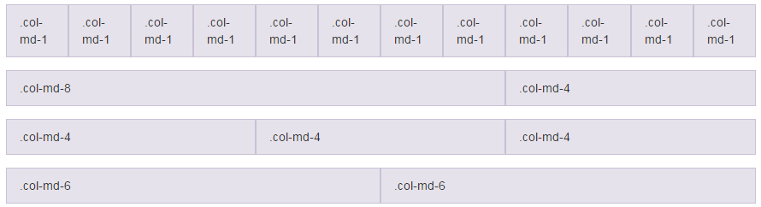
Bootstrap Features

Slide 24

PayPal
Working with PayPal to carry out secure transactions after taxpayers complete their tax form.
Reusable code
Easily modifiable
Built in security
Payment types
Single
Installment
Automated

Slide 25
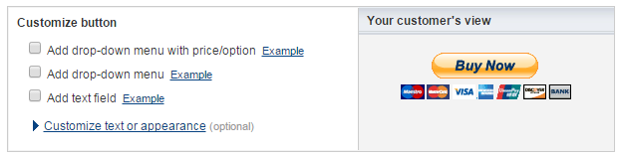
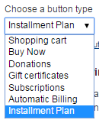
PayPal Features

Slide 26
Current State

Slide 27
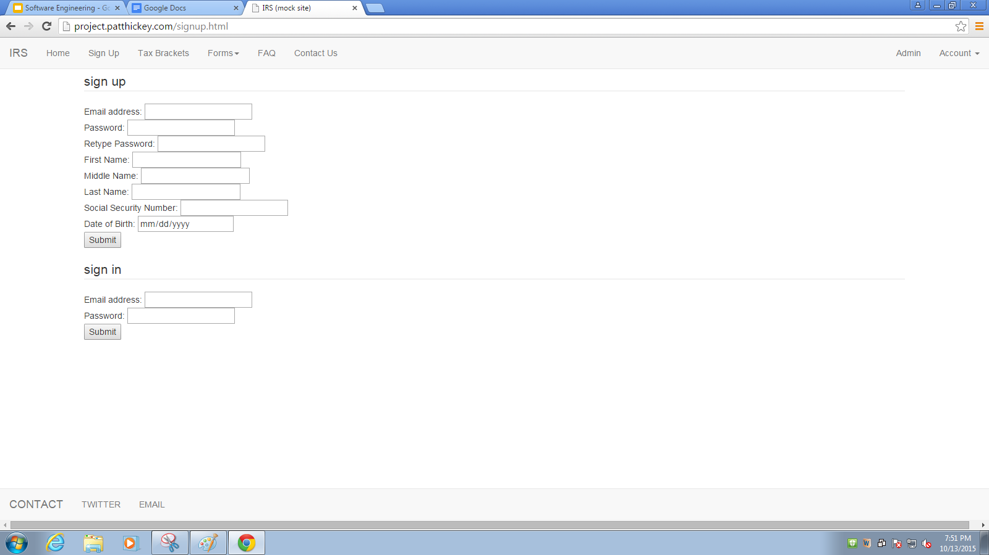
Sign Up / Log In

Slide 28
What’s Next?

Slide 29
Steps to complete
Gather requirements (Ongoing process)
Consult with client (Ongoing process)
Setup code repository (Completed)
Design Website interface (Finishing)
Configure Database tables (Being worked on)
Code front facing site using JavaScript (Being worked on)
Code server side using PHP (Being worked on)
Use Bootstrap to style (Needs completion of earlier tasks)
Test, loop back to review/change any section of the development (Continuously being done)

Slide 30

Result : A Satisfied Customer

